Slide 1

COVID-19 Trend Prediction & Analysis Using Social Media Data
This presentation explores using social media and public datasets. The aim is to analyze trends in active cases, deaths, and vaccinations related to COVID-19. We will review the project overview and key objectives.

Slide 2

Team Members :
1. Hema Naga Chand . B – 2210030313
2. K Varun – 2210030325
3. Sree Vaatsava T V – 2210030307
4. J Sai Teja - 2210030260

Slide 3
Data Sources & Preparation
We utilized COVID-19 data (active cases, deaths) and vaccination data from Kaggle. Data cleaning included handling missing values, removing irrelevant columns, and standardizing data types.
Data Sources
Preparation Steps
COVID-19 Data: Kaggle
Handling Missing Values
Vaccination Data: Kaggle
Removing Irrelevant Columns
Standardization

Slide 4
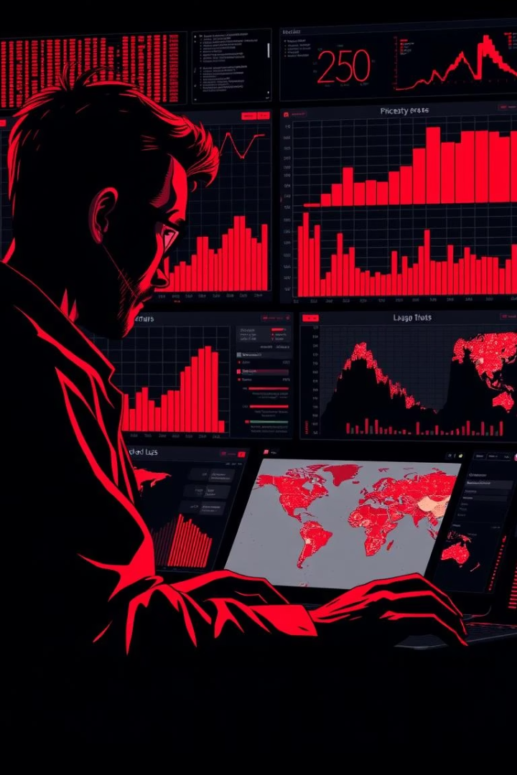
Exploratory Data Analysis (EDA)
The EDA involved univariate analysis (distributions and summary statistics), bivariate analysis (correlation and time series decomposition), and statistical significance testing.
Univariate Analysis
Bivariate Analysis
Correlation between cases, deaths, vaccinations. Time series decomposition.
Distributions of cases, deaths, vaccinations.
Statistical Testing
Applicable significance tests were performed.

Slide 5
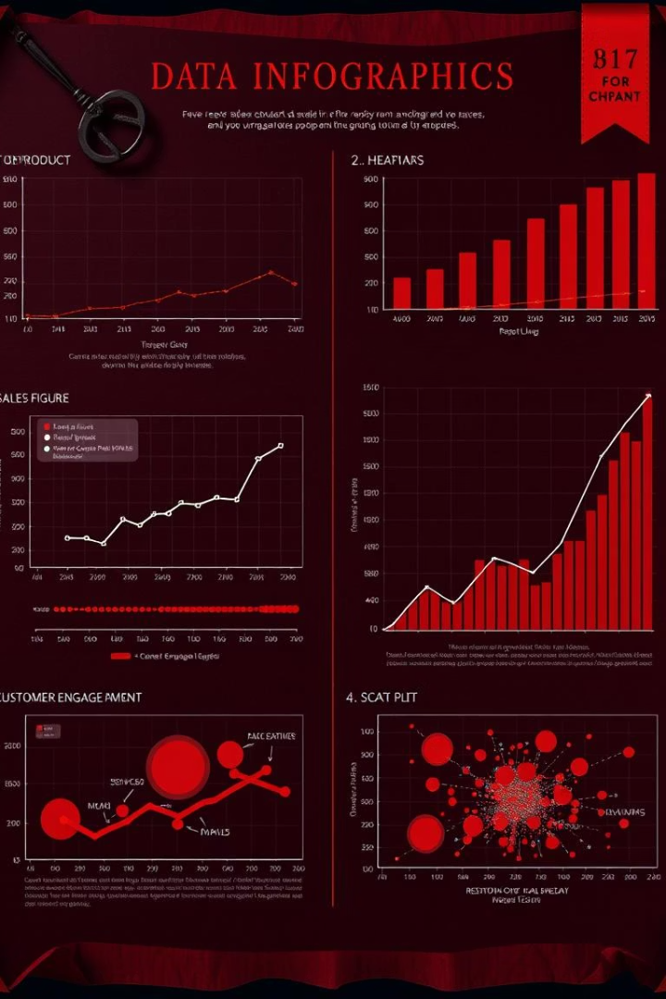



Visualization Techniques
Time series plots showed trends in cases and deaths. Bar charts showed regional variations, and heatmaps showed correlation matrices and geographic distribution.
Time Series Plots
Bar Charts
Heatmaps

Slide 6
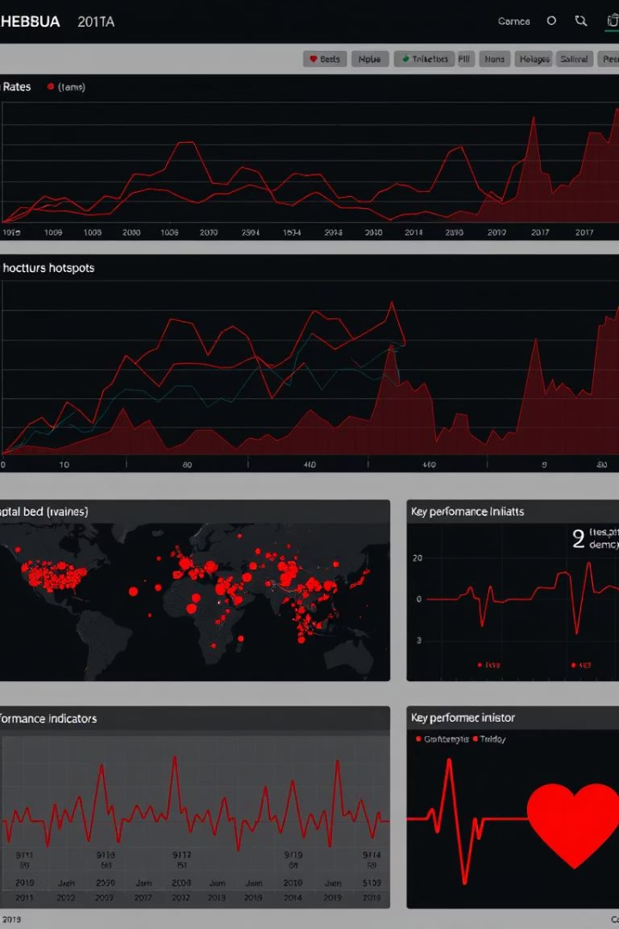



Dashboard Overview (Tableau)
The interactive Tableau dashboard featured filtering and drill-down capabilities, prominently displaying KPIs like daily cases vs. vaccination rates and a mortality heatmap.
Interactive Design
Filtering
Key Metrics

Slide 7

Key Findings & Insights
We found a correlation between social media sentiment and case spikes. Regional disparities and the predictive power of social media on COVID-19 spread were identified.
1
Social Media Sentiment
2
Regional Disparities
Correlation with case spikes.
Areas with higher/lower case rates.
3
Predictive Power
Social media on COVID-19 spread.

Slide 8
Limitations & Future Work
Data limitations included potential biases in social media data and geographic restrictions. Future improvements involve incorporating more datasets and developing machine learning models.
1
Data Limitations
2
Potential Improvements

Slide 9

Conclusion
The dashboard’s value for informed decision-making was emphasized. Findings included correlation between social media sentiment and case spikes. Any questions?

